Slide 1
Analysis Dataset Construction
Andras Varady
Modelling and Analytics, BNSSG CCG

Slide 2
Please note: “Analysis Dataset”, “’segment” and “cohort” are used interchangeably in this presentation, and refer to the same thing: a subset of your Population Dataset (your entire population)
Other guides use “segment” and “cohort” to refer to different subsets of the data (i.e. will not be referring to the Analysis Dataset)
Your screen resolution may result in a different visual experience

Slide 3
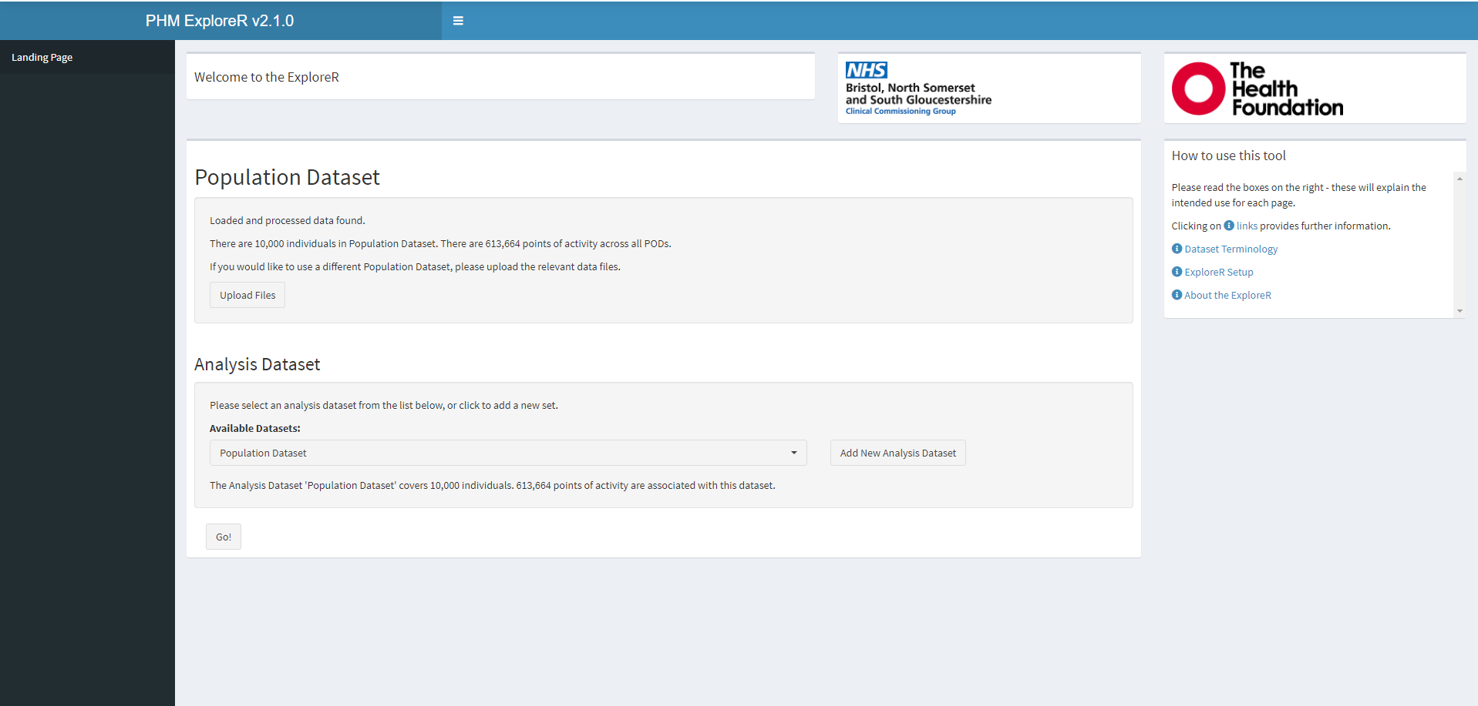
By default, the entire Population Dataset is selected
Population dataset = everyone in the data uploaded
Click this button

Slide 4
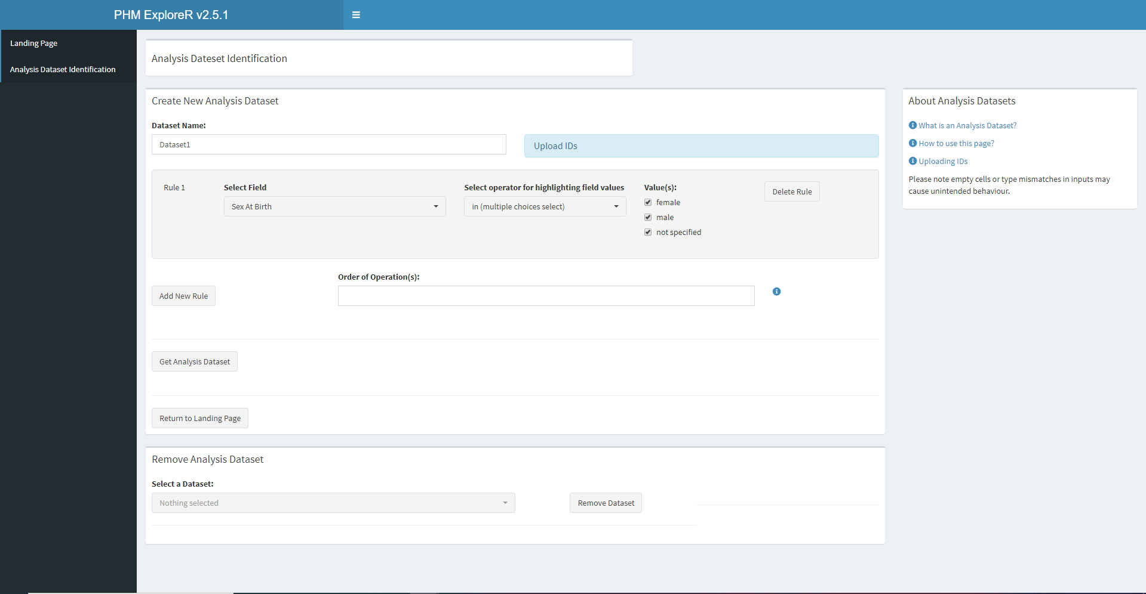
Analysis Dataset page default look
Info in sidebar

Slide 5

It is generally recommended you give your Analysis Dataset a sensible name

Slide 6
How this page works
Once you have a definition for the population segment of interest, translate the definition into a series of simple rules
Patients are then selected by creating a series of conditions using attributes, and selecting which values of each field means inclusion.
This probably sounds complicated, so let’s look at a couple of examples

Slide 7
Example 1: selecting all adults with hypertension
Two parts to this Analysis Dataset: adults and having hypertension
Adults means we need age >= 18
AND must have hypertension
Look at the next couple of slides to see how to set this up.

Slide 8
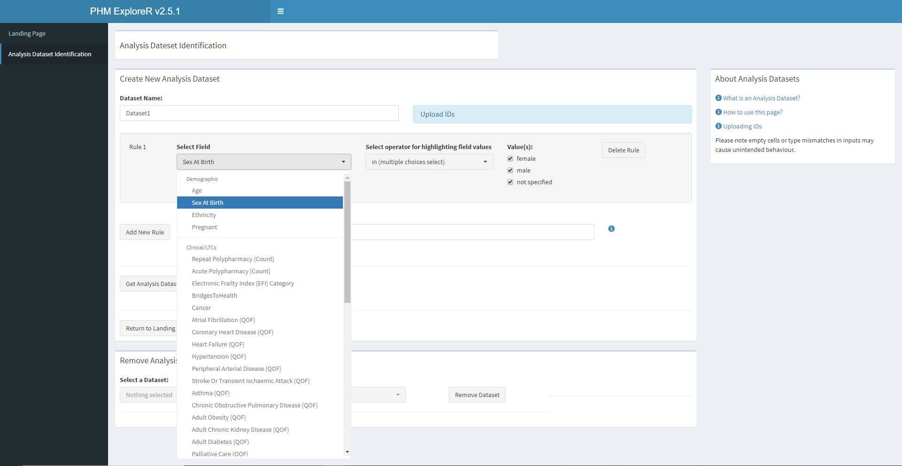
Select the Age field

Slide 9
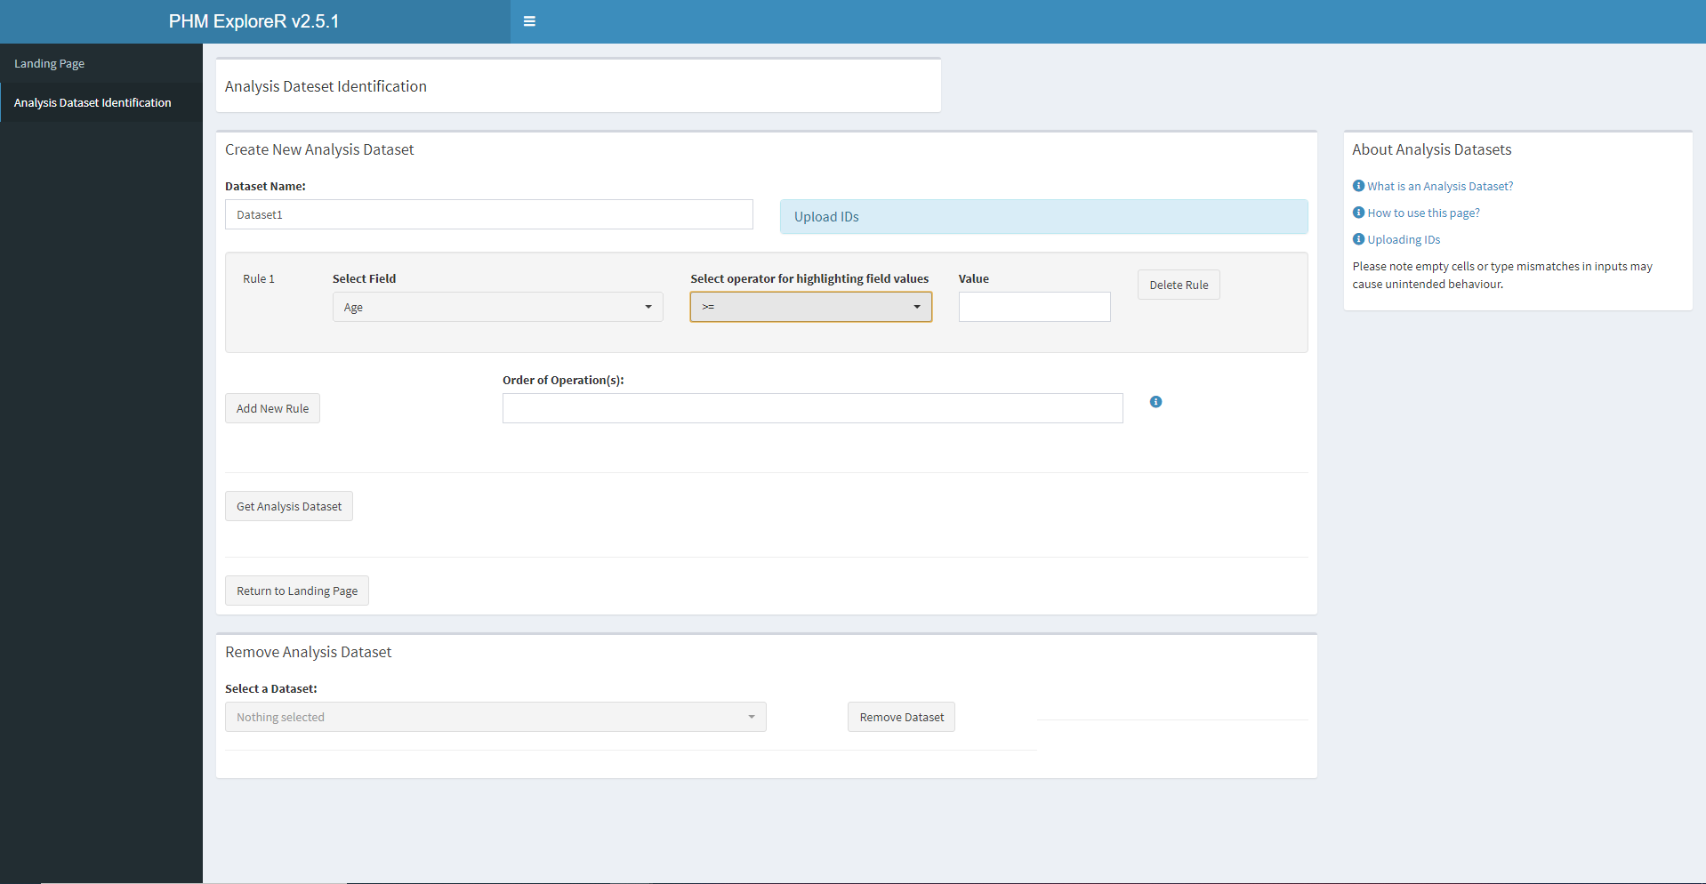
Select ‘>=‘ operator

Slide 10

Enter 18 as lower bound for age

Slide 11
To add hypertension as criteria, we need to add another field. Press ‘Add New Rule’
Button to add new field

Slide 12
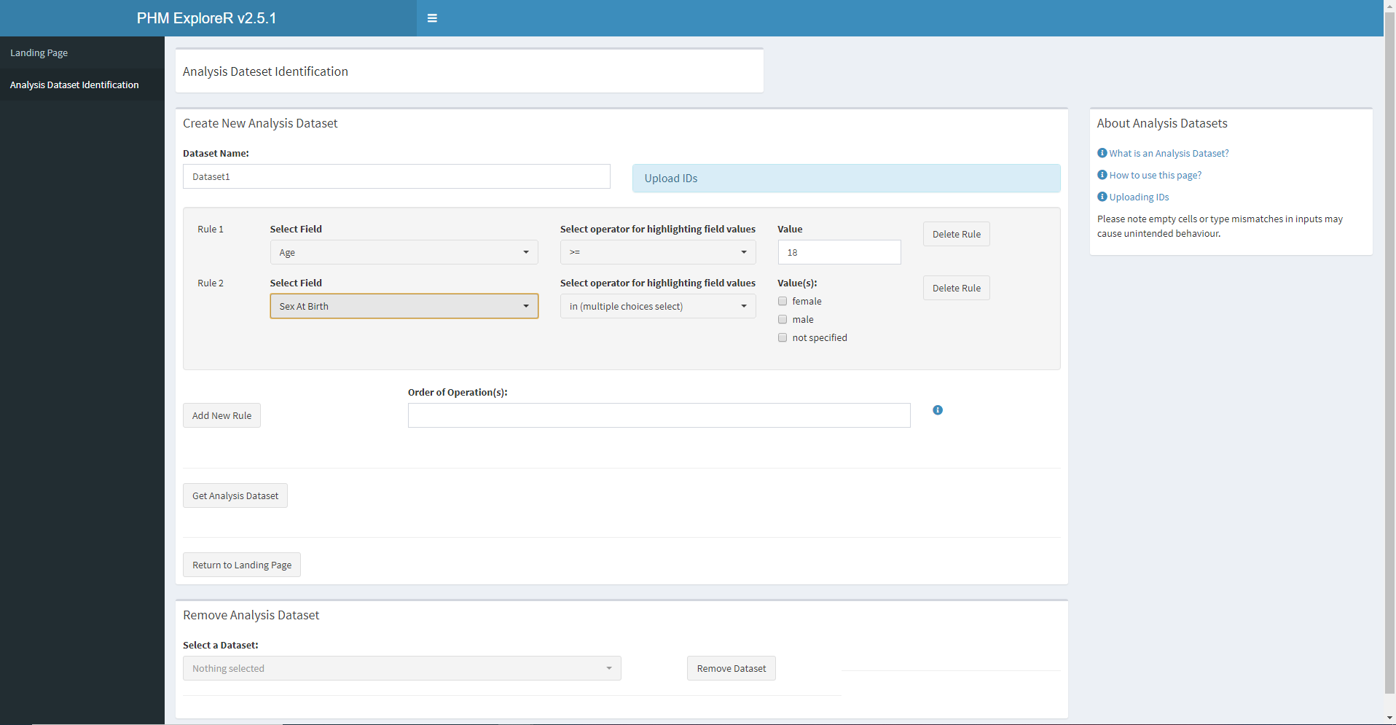
Once the 2nd rule is added, select hypertension

Slide 13
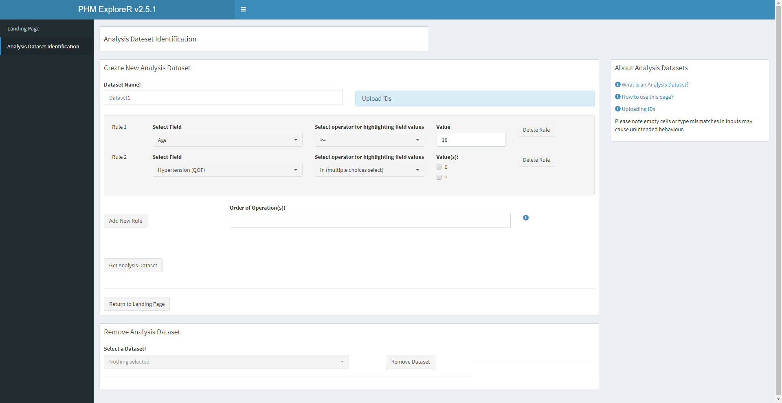
Select value 1 (patient has hypertension)

Slide 14

Write out logic clause

Slide 15
Joining rules
Users need to construct a logic statement to join the rules together
These can consists of brackets, numbers (corresponding to rules) and the words ‘AND’ or ‘OR’
As we want all 18+ patients with hypertension we write: ‘1 AND 2’
Only individuals who satisfy the conditions are included in the analysis dataset

Slide 16

Now we can get our Analysis Dataset

Slide 17
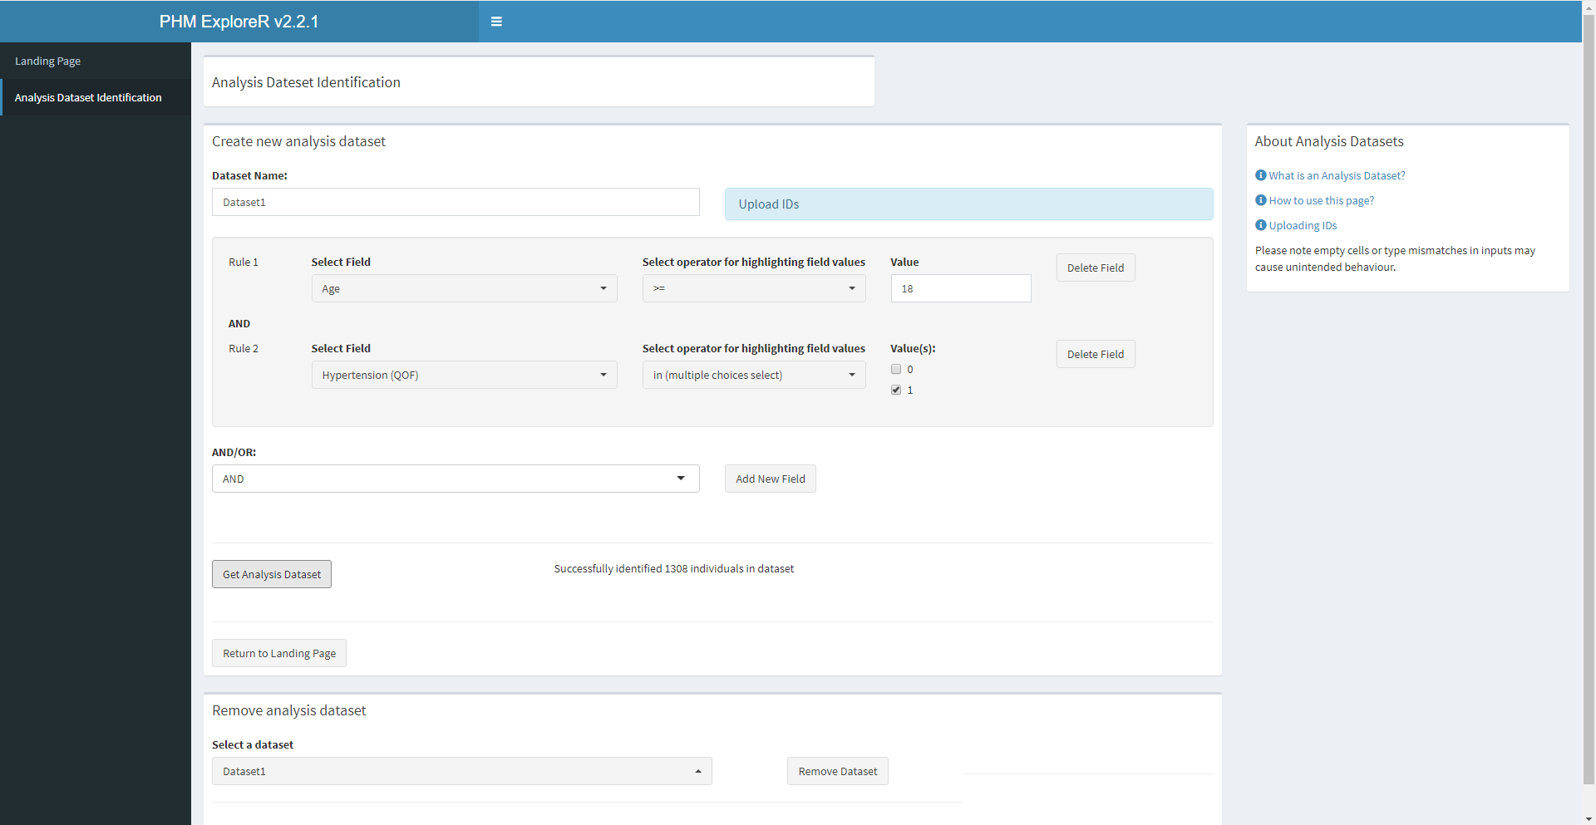
A success message is displayed.

Slide 18
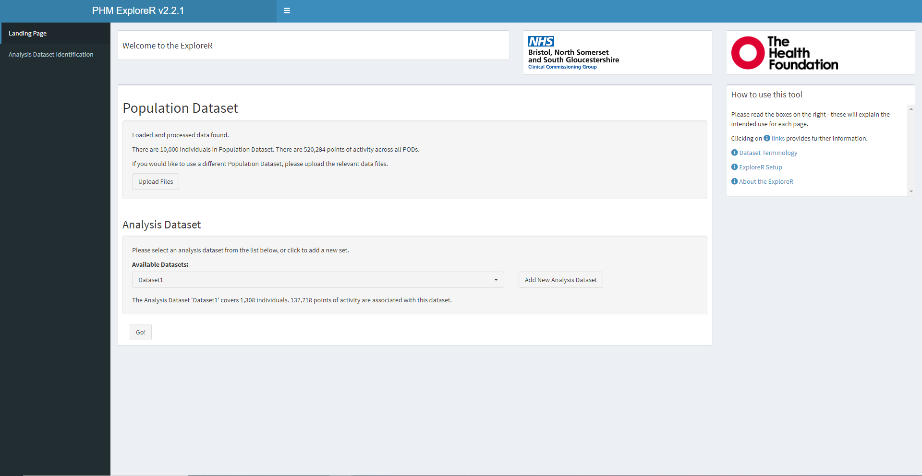
Returning to the landing page, we can see the new Analysis Dataset in the dropdown

Slide 19
Another worked example
Select all adults with hypertension or mental health (QOF)
See next page for a solution

Slide 20
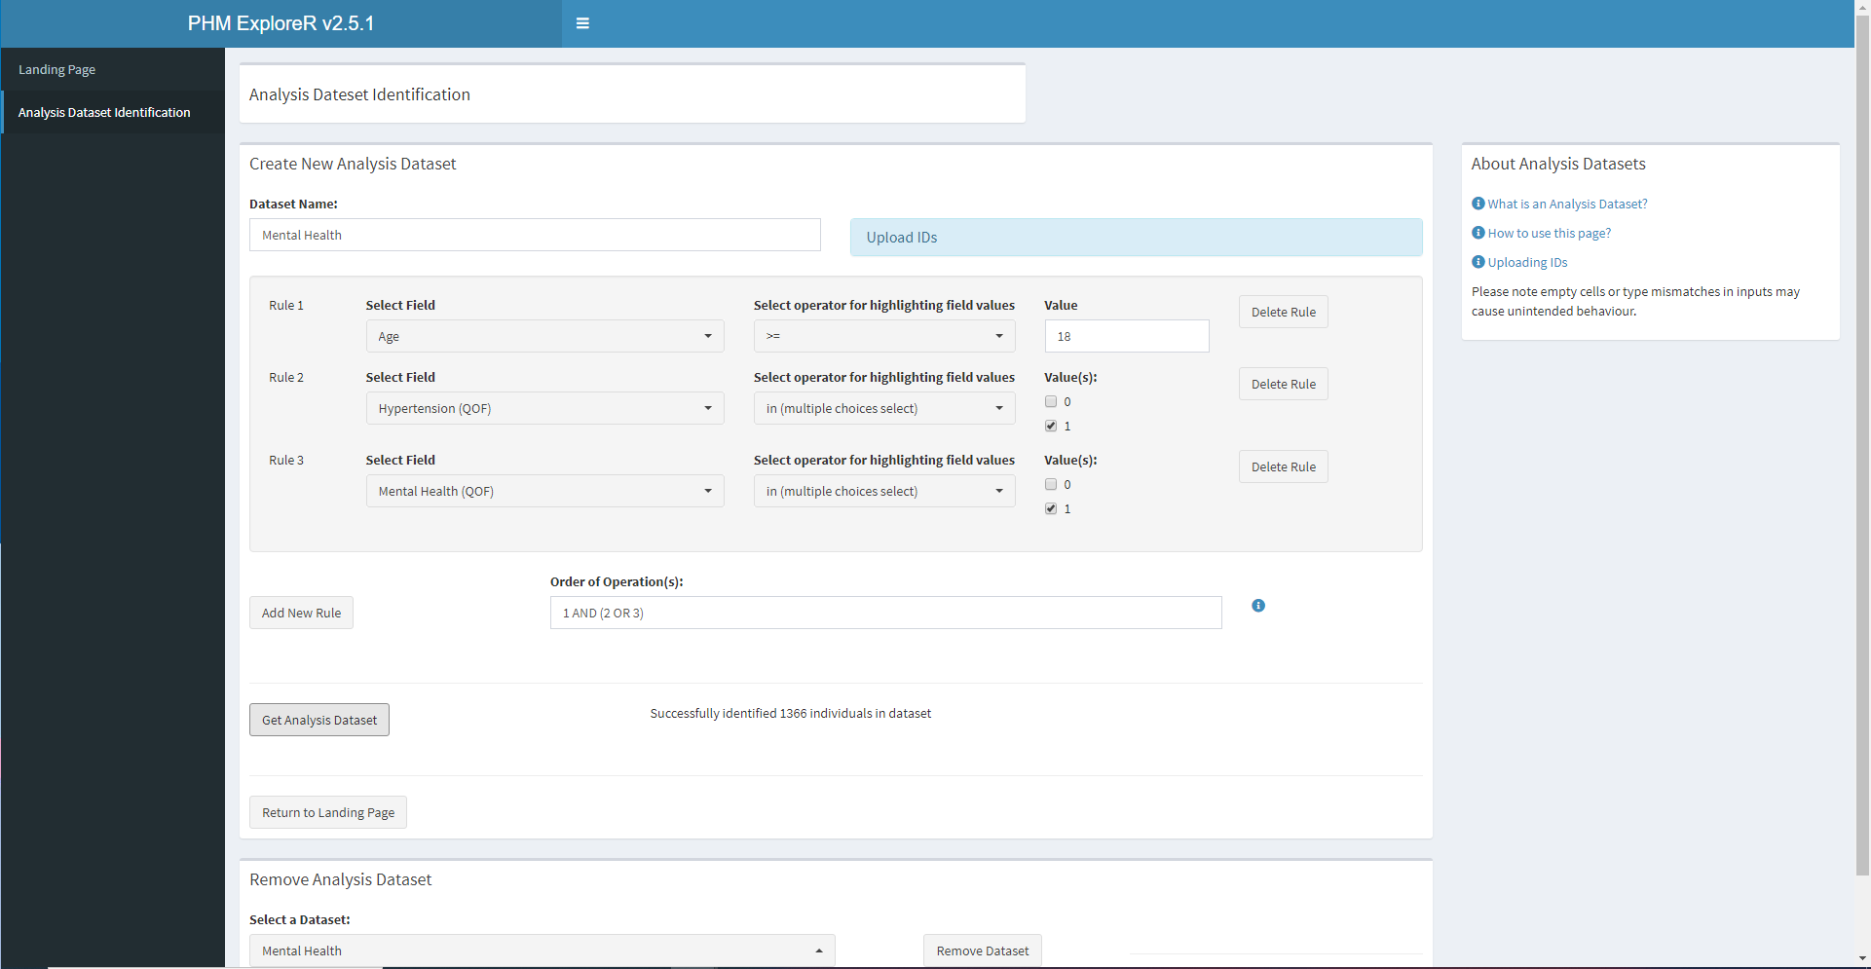
Another worked example: select all adults with hypertension or mental health (QOF)

Slide 21
Additional features

Slide 22

If you already have a particular cohort, upload a .csv file with IDs – see sidebar for tips

Slide 23
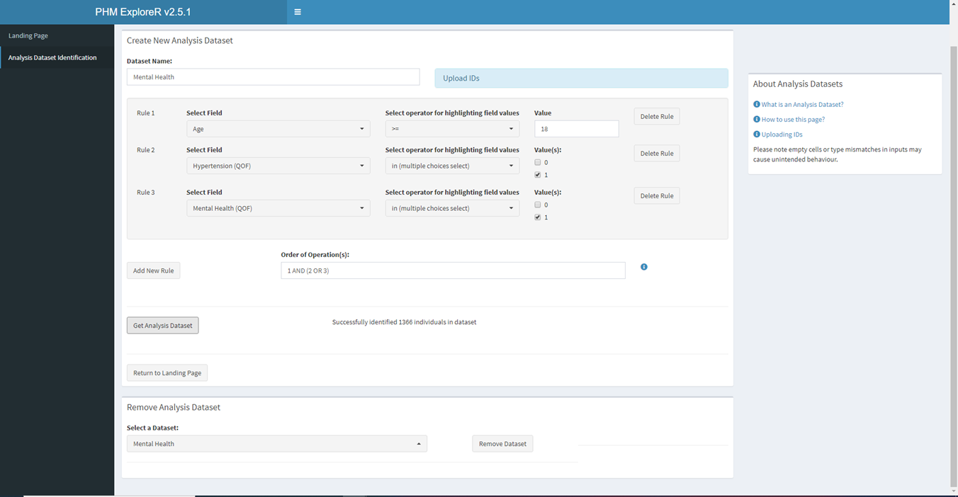
You can also remove existing analysis datasets to reduce clutter

